Slide 1

Mini - VR Workshop Build Your First VR Experience with Unity + XR Toolkit
Alicia Esquivel Morel
Graduate Instructor
TigerHacks 2025, Saturday 8th November – VR Lab
College of Engineering | Information Technology | University of Missouri – Columbia

Slide 2

What You’ll Do Today
TigerHacks 2025- Mini VR Workshop
You will learn how to:
Set up a Unity project for VR
Add a VR player (headset + controllers)
Move using teleportation
Grab and interact with virtual objects
Try examples of more advanced VR interactions
No experience required, let’s go!
Notes:
Core foundation for future interaction design

Slide 3
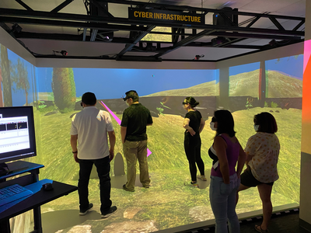

TigerHacks 2025- Mini VR Workshop
What is VR and Why It Matters
VR creates a sense of presence – feeling like you are inside the virtual world
The goal is to trick your brain into treating virtual objects and spaces as real
VR is used in:
Games and entertainment
Education and training
Health and therapy
Architecture and design
Remote collaboration and simulation
Research at MU has been advancing the applications and uses of VR technology.

Slide 4
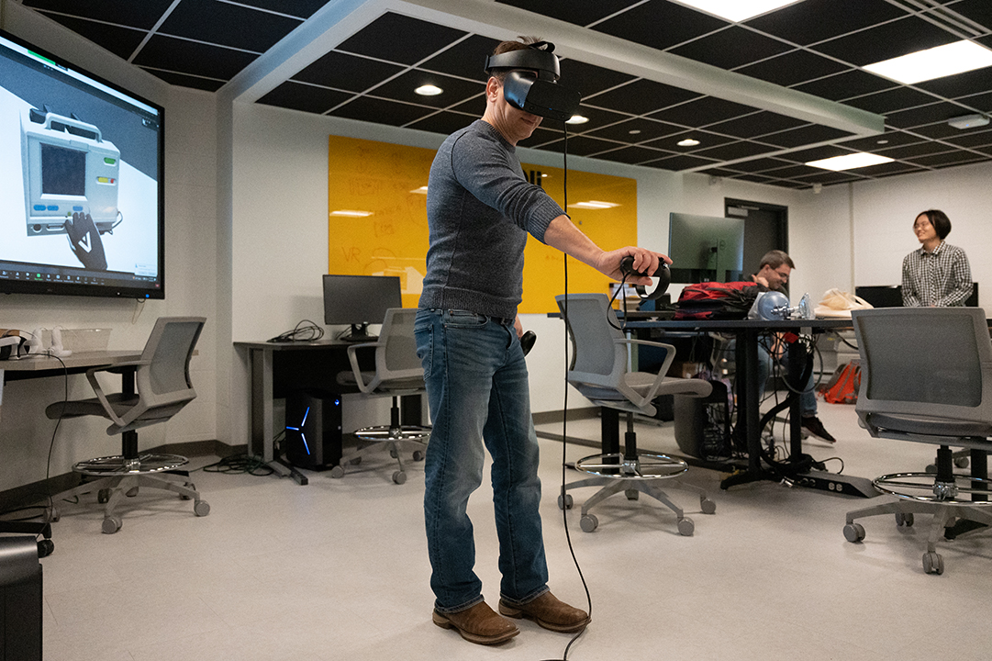
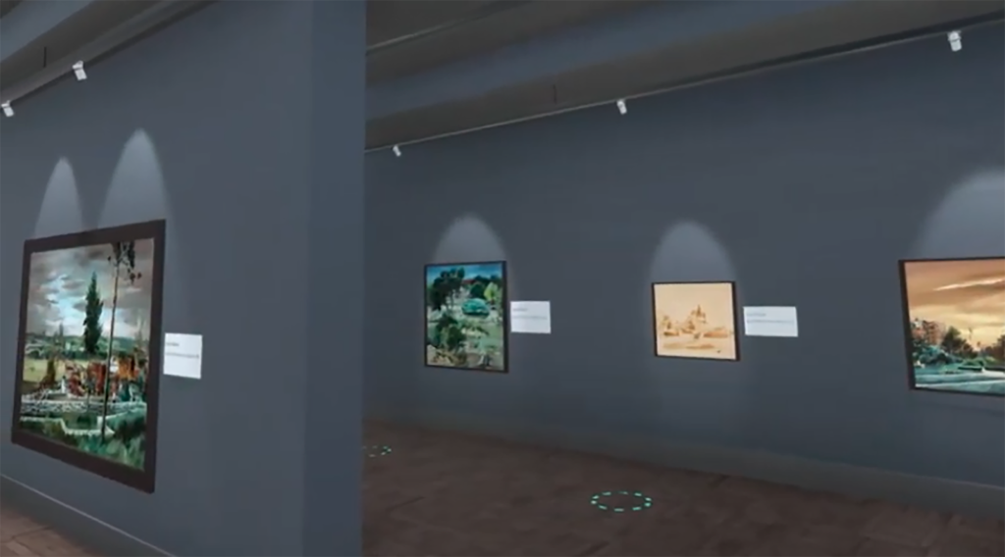
What Makes Good VR
TigerHacks 2025- Mini VR Workshop
Natural interaction: grab, touch, push, look — not just mouse clicks
Comfortable movement — avoid sudden motion to reduce motion sickness
Correct scale — objects should feel real in size and distance
A clear purpose — explore, build, solve, learn, simulate
An image of the virtual museum, available in the Oculus Rift Store

Slide 5
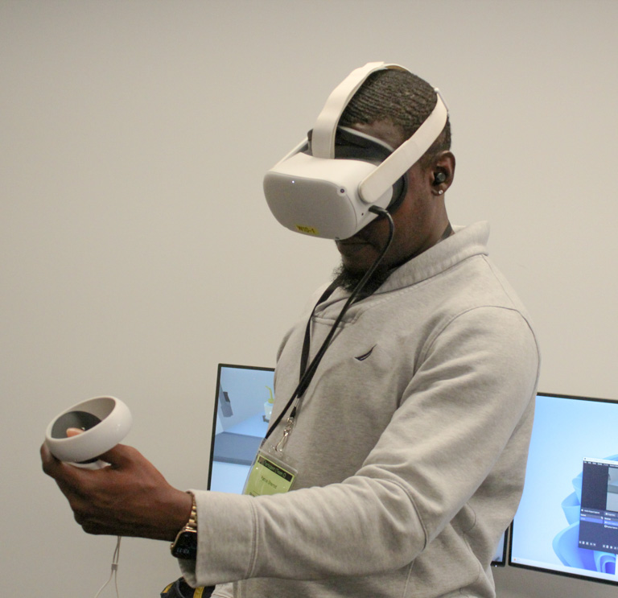
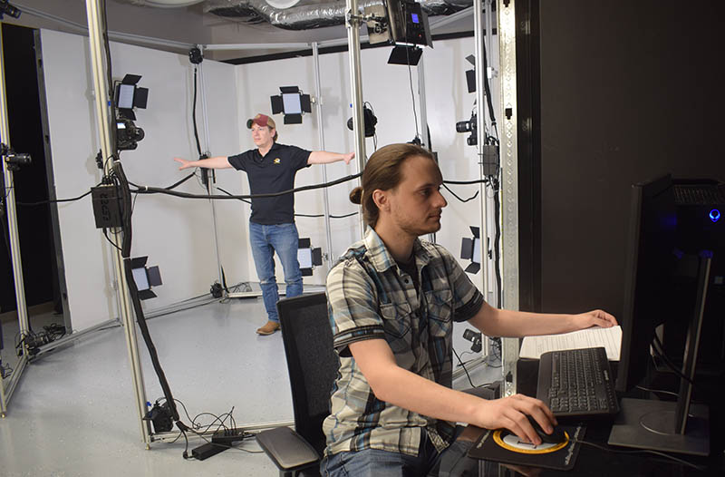
Things to Keep in Mind
TigerHacks 2025- Mini VR Workshop
VR users are physically moving → requires safe space
Headsets can cause fatigue or nausea if poorly designed
Users are visually and audibly isolated from the real world
Hardware is still expensive → Unity makes VR development more accessible
The motion capture system takes images from all angles to turn people into digital avatars.

Slide 6
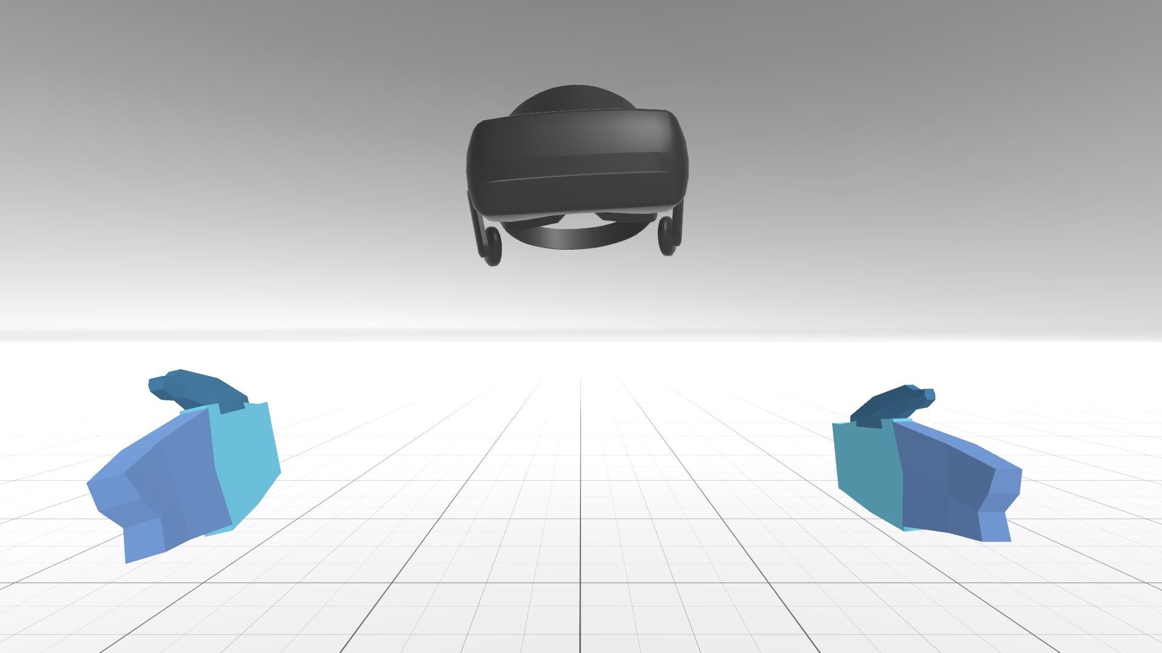
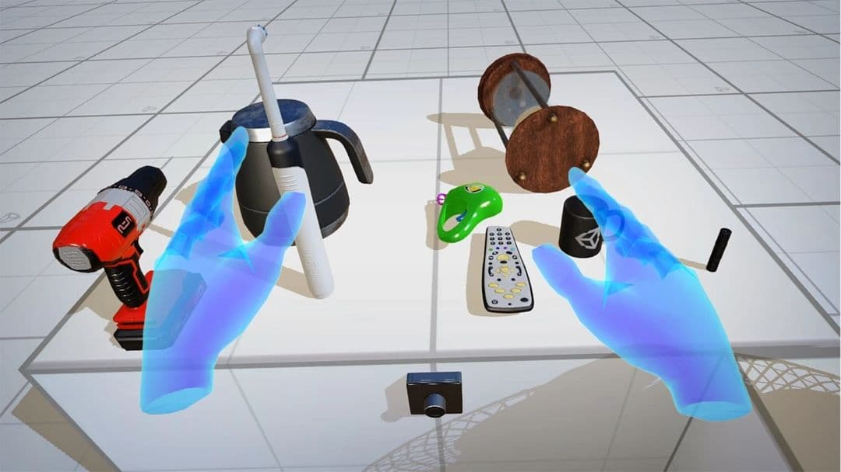
What You Will Build Today
TigerHacks 2025- Mini VR Workshop
By the end of this session, you will have:
A working Unity VR project
A player rig (head + hands)
Teleport locomotion
Grabbable, throwable physics object

Slide 7
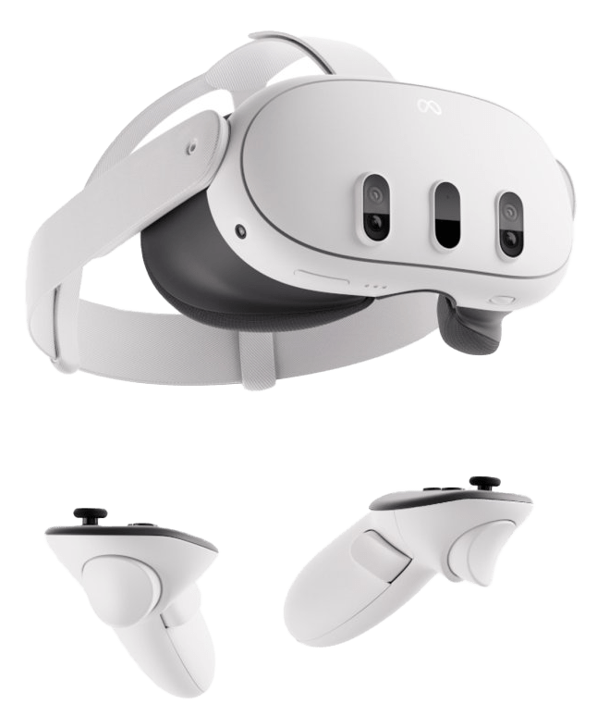


Step 1: Create a New Unity Project
TigerHacks 2025- Mini VR Workshop
Open Unity Hub → New Project
Template: 3D (URP or Core 3D)
Name it: TigerHacks_VR
Create
Information Technology (IT)

Slide 8
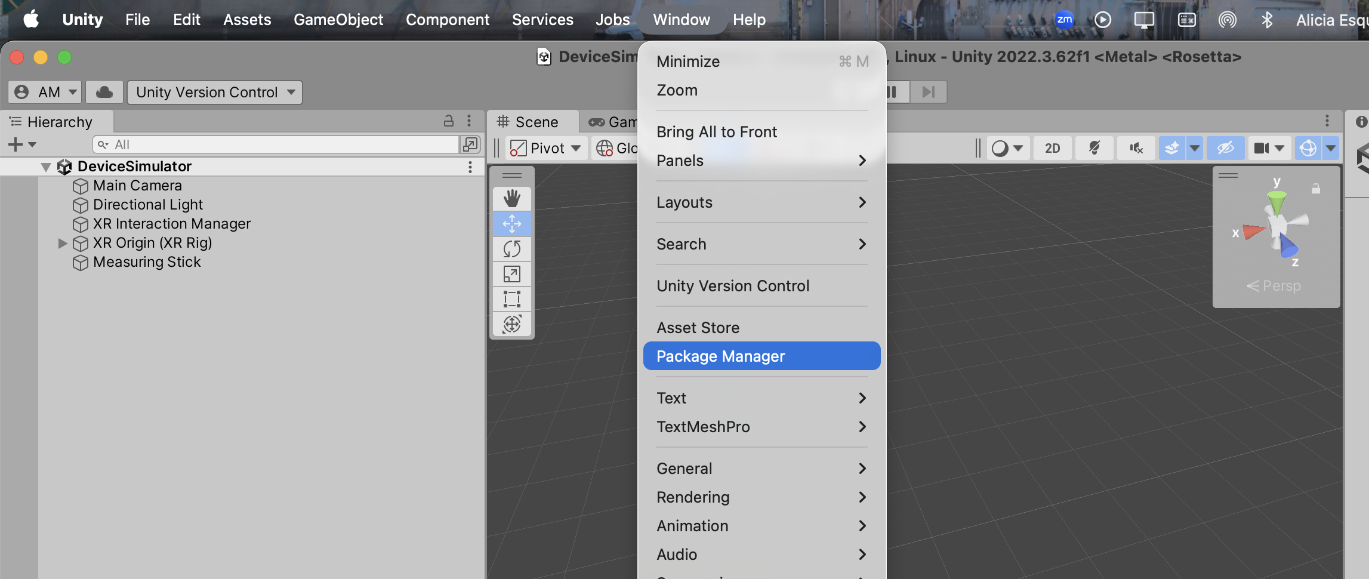
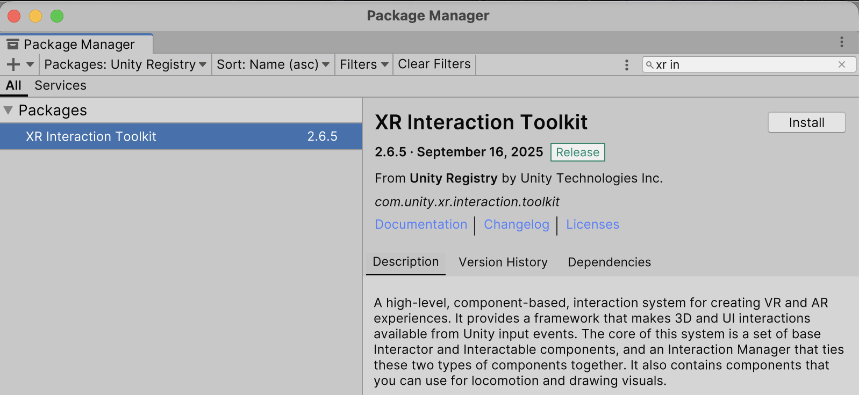
Step 2: Install VR/XR Packages
TigerHacks 2025- Mini VR Workshop
Window → Package Manager
Enable “Show Preview Packages”
Install:
XR Interaction Toolkit
XR Plugin Management
Go to Edit → Project Settings → XR Plugin Management → Enable OpenXR
If prompted: Import XR Interaction Input

Slide 9
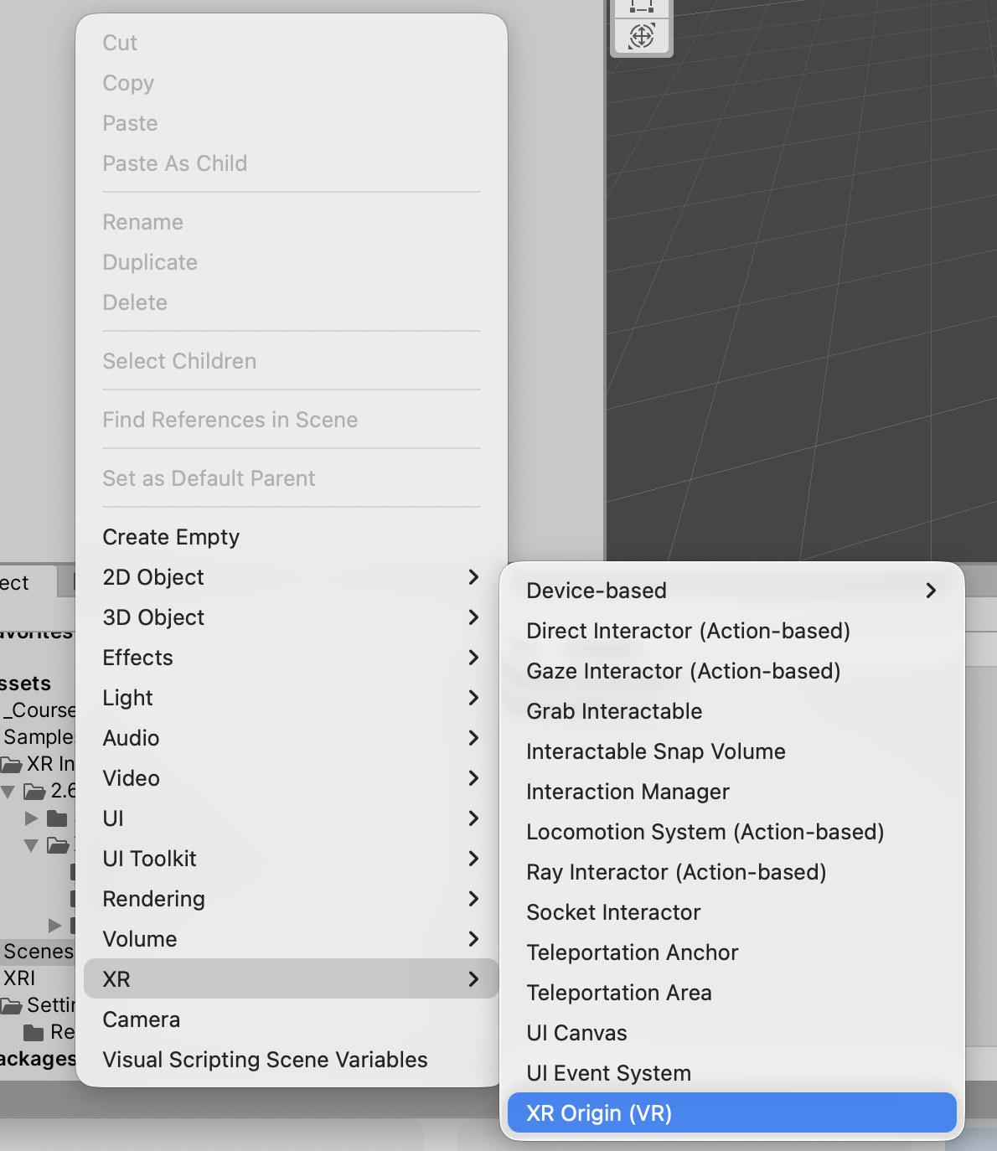

Step 3: Add a VR Player (XR Rig)
TigerHacks 2025- Mini VR Workshop
In Hierarchy: Right-click → XR → XR Origin
This adds:
Main Camera (your head)
Left & right controllers
Press Play while wearing headset → you are inside the scene

Slide 10
Step 4: Add Floor + Teleportation
TigerHacks 2025- Mini VR Workshop
Right-click → 3D Object → Plane → name it Floor
Add Component → Teleportation Area
Now you can point your controller and teleport to move

Slide 11
Step 5: Add a Grabbable Object
TigerHacks 2025- Mini VR Workshop
Right-click Hierarchy → 3D Object → Cube
Position at (0, 1, 1)
Add Component → Rigidbody
Add Component → XR Grab Interactable
Enter Play Mode → Grab and throw it in VR

Slide 12
You Just Built VR Interaction
TigerHacks 2025- Mini VR Workshop
Now your scene includes:
A VR camera that follows your head
Controllers that interact with objects
Teleport movement
Physics-based grabbing and throwing
Put on your headset,
It’s VR time

Slide 13
Next: Live Demo and Headset Tryout
TigerHacks 2025- Mini VR Workshop
Try the scene you built
Explore advanced VR interactions
Ask questions or get help
Explore after the workshop:
Unity Learn – VR Beginner Pathway
Ask for today’s project files on request

Slide 14
Thank you!
Alicia Esquivel Morel
Graduate Instructor
E2437B Lafferre Hall | ace6qv@missouri.edu
Engineering and Information Technology

